Slide 1
LLM - Detect AI Generated Text
Project Group 21:
Pengzhen XIAO
DI LIN

Slide 2

LLM - Detect AI Generated Text

Slide 3
LLM - Detect AI Generated Text
1. Data preprocessing
2. Feature extraction
3. Clustering
4. Dimension Reduction
5. Try Various Classifiers

Slide 4

1. Data preprocessing
Add external data & random split data
Text pre-processing
…

Slide 5
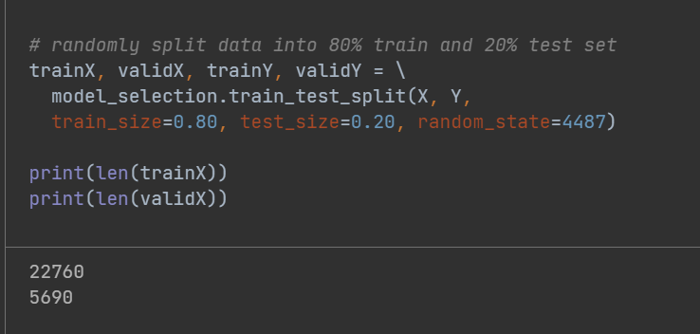
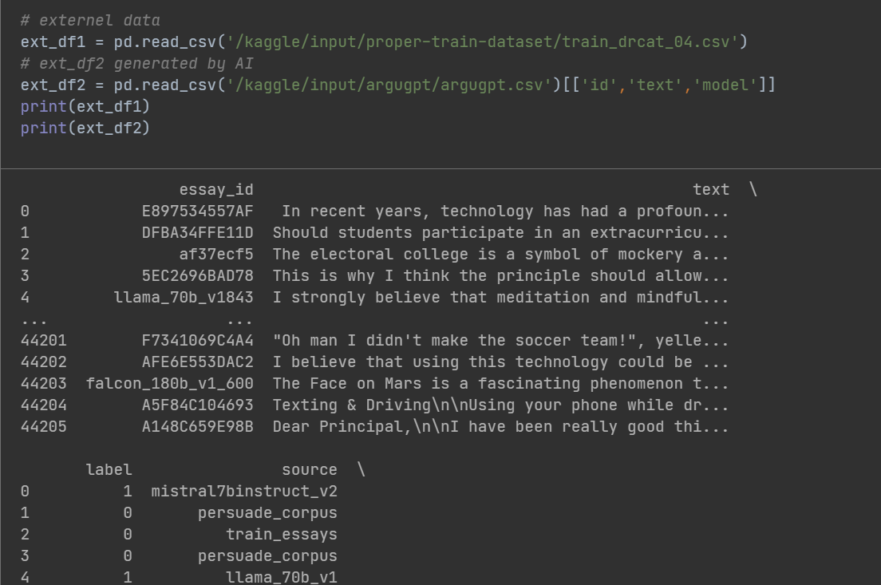
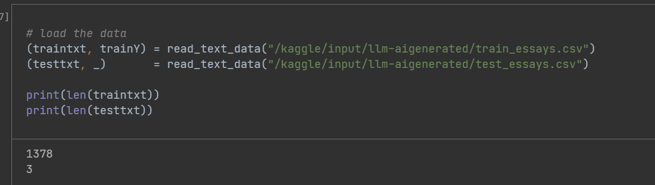
We'll be utilizing the following external datasets: Proper Train Dataset: https://www.kaggle.com/datasets/thedrcat/daigt-proper-train-dataset/ @thedrcat ArguGPT: https://www.kaggle.com/datasets/alejopaullier/argugpt @alejopaullier randomly split data into 80% train and 20% test set
Add external data & random split data

Slide 6
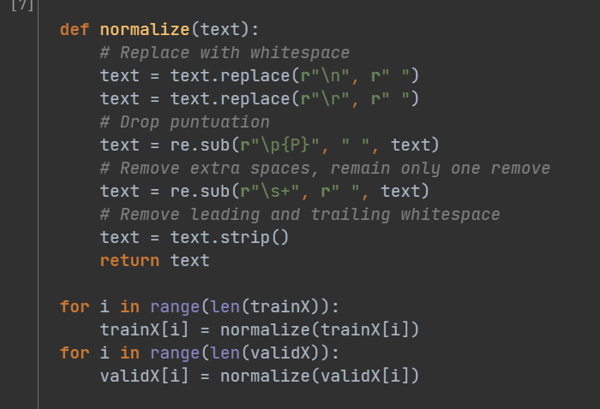
1. Replace with whitespace 2. Drop punctuation 3. Remove extra spaces, remain only one remove 4. Remove leading and trailing whitespace
Text pre-processing

Slide 7

2. Feature extraction
BoW
TF-IDF
…

Slide 8
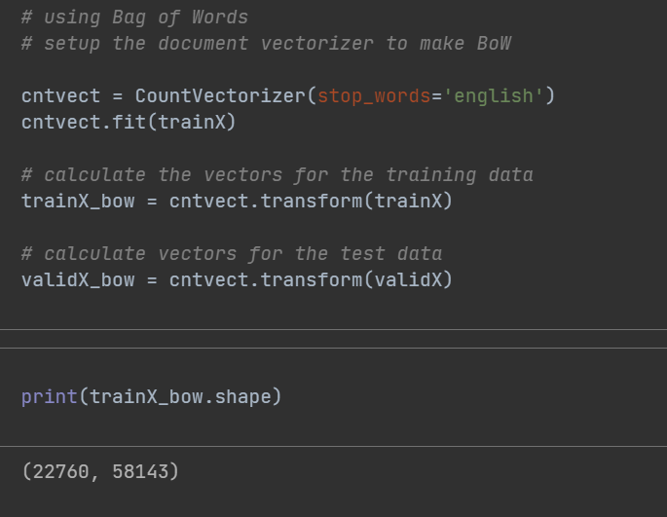
Using Bag-of-Words (BoW) model
The Bow model converts a collection of text documents to a matrix of token counts. When using the bag-of-words model, we also need to perform parameter tuning to determine the optimal value of max_features.
The parameter tuning idea is as follows: First, we calculate the number of words in the training text and the test text (not repeated), and take the larger value of the two as the upper bound of the parameter max_features. After that, we determine the parameter space of max_features, use the BernouliNB model for cross-validation, and obtain the model with the highest score and the optimal value of max_features. This is parameter tuning in the feature extraction step.

Slide 9
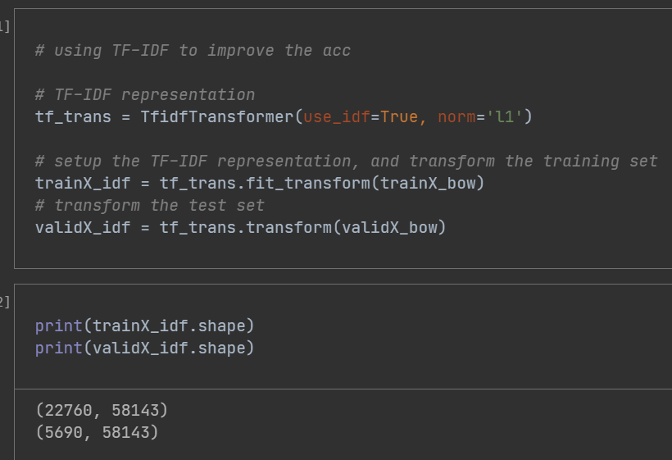
Using TF-IDF model to improve the acc
The bag-of-words model has shortcomings, including not considering the order of words and failing to reflect the keywords in a sentence. Now we consider using the number of times each word appears in the document to bulid the model, which is TF-IDF model.
We use the TF-IDF model for feature extraction. Similar to the bag-of-words model, the TF-IDF model we use also needs to be tuned. We also tested the BernouliNB model on the extracted feature vectors and performed cross-validation by trying different parameter values (max_features) to obtain the best score and the optimal value of max_features.

Slide 10

3. Clustering
k-means
MeanShift Clustering
Bisecting KMeans
MiniBatch KMeans
Affinity Propagation
…

Slide 11
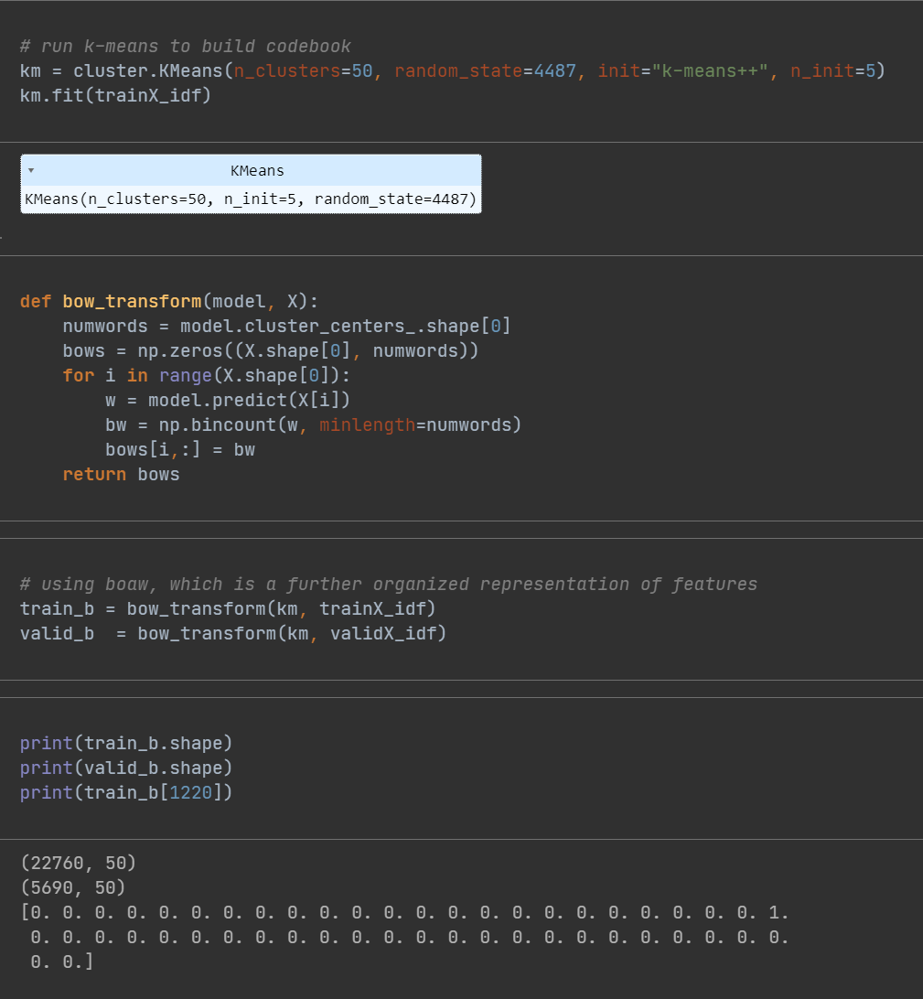
run k-means to build codebook
The K-Means algorithm clusters data by trying to separate samples in n groups of equal variance, minimizing a criterion known as the inertia or within-cluster sum-of-squares (see below). This algorithm requires the number of clusters to be specified. It scales well to large numbers of samples and has been used across a large range of application areas in many different fields.

Slide 12

4. Dimension Reduction
PCA
NMF
TruncatedSVD
…

Slide 13
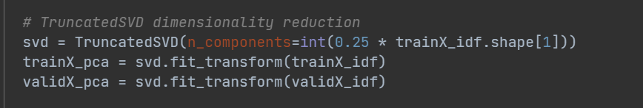
TruncatedSVD
SVD transformer performs linear dimensionality reduction by means of truncated singular value decomposition (SVD). Contrary to PCA, this estimator does not center the data before computing the singular value decomposition. This means it can work with sparse matrices efficiently.
I will try TruncatedSVD on ''trainX_idf & 'validX_idf', trying different n_components to find best n_components.

Slide 14

5. Try Various Classifiers
BernoulliNB classifier
Logistic Regression classifier
SGD Classifier
Voting Classifier
Random Forest Classifier
AdaBoost Classifier
….

Slide 15
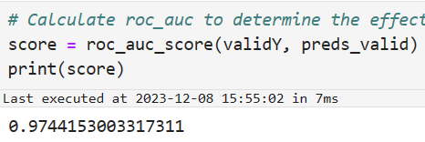
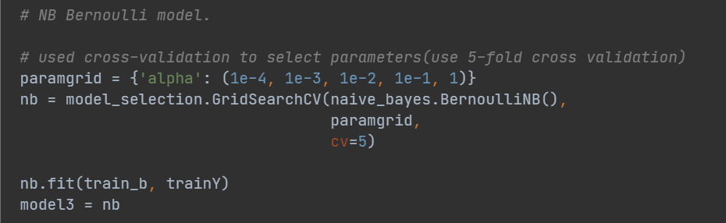
BernoulliNB classifier
In BernoulliNB, the most important parameter is alpha, which is the additive (Laplace/Lidstone) smoothing parameter (set alpha=0 and force_alpha=True, for no smoothing). We will define logarithmic space for this smoothing parameter, by grid search and cross-validation are used to obtain the best alpha value and best score.

Slide 16
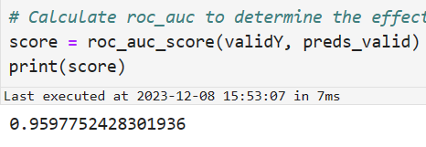
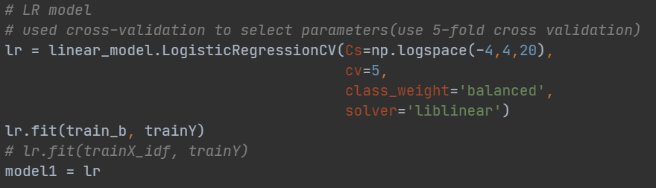
Logistic Regression classifier
In Logistic Regression model, the most important parameters is C, which is inverse of regularization strength, C must be a positive float. Like in support vector machines, smaller values specify stronger regularization.

Slide 17
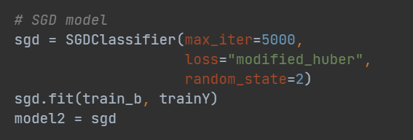
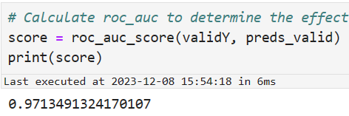
SGD Classifier
Linear classifiers (SVM, logistic regression, etc.) with SGD training.
This estimator implements regularized linear models with stochastic gradient descent (SGD) learning: the gradient of the loss is estimated each sample at a time and the model is updated along the way with a decreasing strength schedule (aka learning rate). SGD allows minibatch (online/out-of-core) learning via the partial_fit method. For best results using the default learning rate schedule, the data should have zero mean and unit variance.

Slide 18
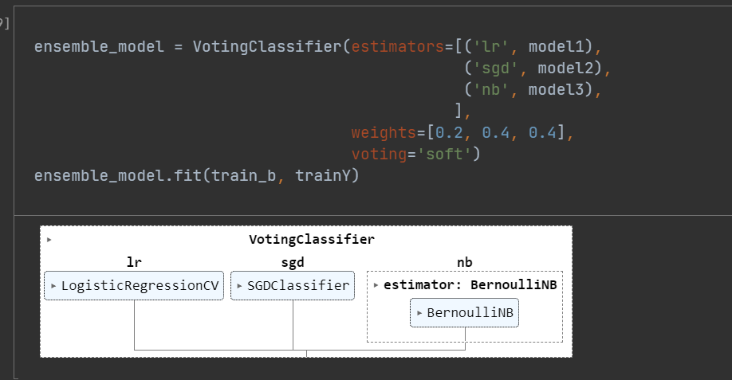
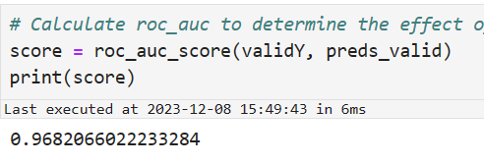
Voting Classifier
The idea behind the VotingClassifier is to combine conceptually different machine learning classifiers and use a majority vote or the average predicted probabilities (soft vote) to predict the class labels. Such a classifier can be useful for a set of equally well performing models in order to balance out their individual weaknesses.

Slide 19
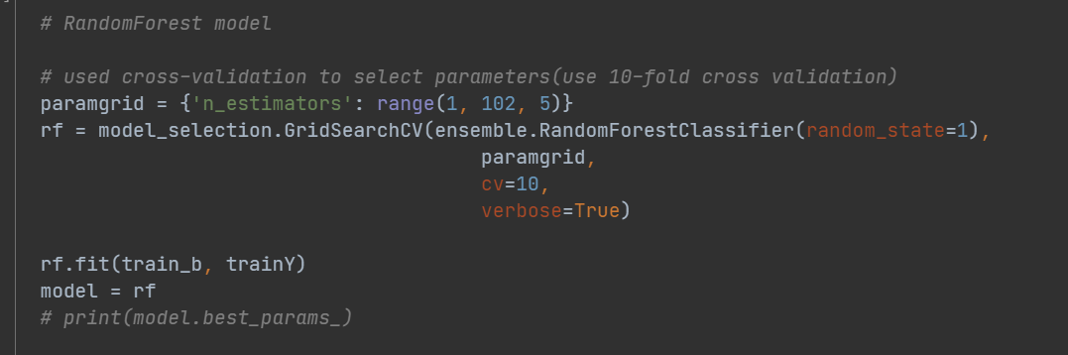
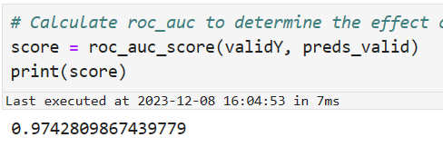
Random Forest Classifier
A random forest is a meta estimator that fits a number of decision tree classifiers on various sub-samples of the dataset and uses averaging to improve the predictive accuracy and control over-fitting.
Important parameters include n_estimators, max_features, max_depth, min_samples_split and min_samples_leaf.

Slide 20
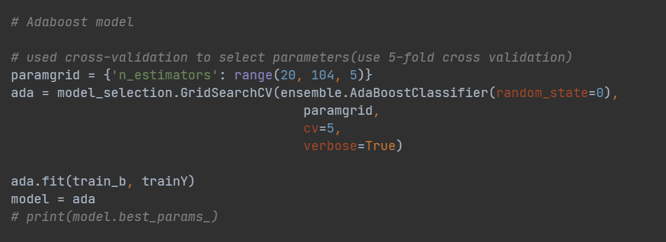
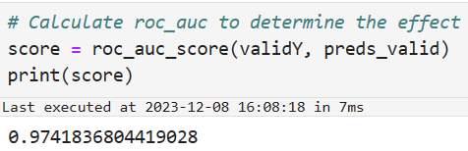
AdaBoost Classifier
An AdaBoost classifier is a meta-estimator that begins by fitting a classifier on the original dataset and then fits additional copies of the classifier on the same dataset but where the weights of incorrectly classified instances are adjusted such that subsequent classifiers focus more on difficult cases.
The main parameters for AdaBoost is learning_rate and n_estimators. n_estimators is the maximum number of estimators at which boosting is terminated. In case of perfect fit, the learning procedure is stopped early. learning_rate is the weight applied to each classifier at each boosting iteration. A higher learning rate increases the contribution of each classifier. There is a trade-off between the learning_rate and n_estimators parameters. We will try grid search and cross-validation to find optimal learning_rate and n_estimators in the range.

Slide 21

Predict
Finally, in order to improve the generalization ability, accuracy and stability of the model, we use VotingClassifier. We combine LR, SGD and NB Bernoulli into a classifier with weights of 0.2, 0.4, 0.4. We hope that this approach will enable the model to maintain stability in the final predictions.

